Slide 1

LA Crime Data Analysis 2020 - 2023
Phil Klimkewicz
Edwin Lovera
Micah purdome
Vickram dass

Slide 2
“It’s one small step for man, one giant leap for mankind.”
- Neil Armstrong

Slide 3
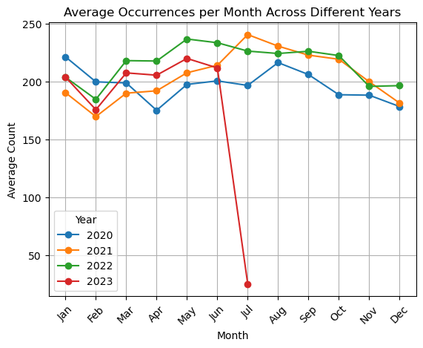
LA Crime during Covid Lockdown March 19, 2020-January25, 2021
Phil Klimkewicz dissected the covid data from the full set of data to determine if violent crimes were lower or higher during the California covid lockdown. The first graph show the average violent crime for each year.

Slide 4
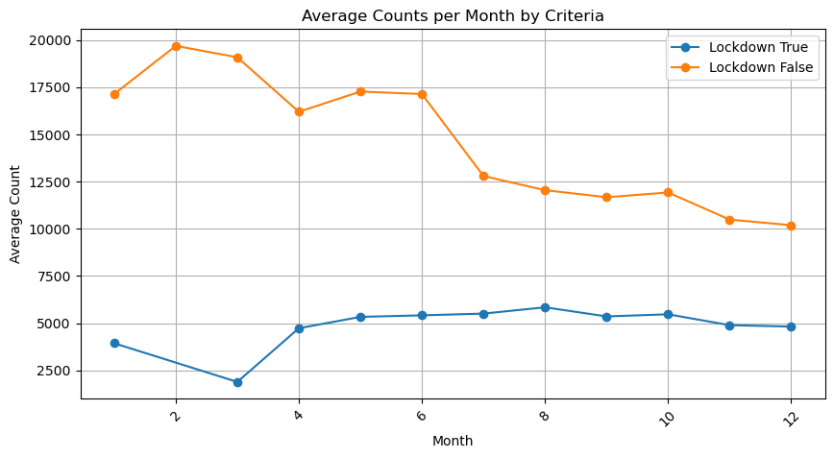
LA Crime during Covid Lockdown March 19, 2020-January25, 2021
Based on the first slide you may think that the average violent crime per month in 202 was lower which may indicate that violent crime for the covid lockdown may have had an impact. The second graph does who that the average violent crome that occurred during the time of the Covid Lockdown was significantly lower that the average for other moths that were not during the covid lockdown.

